Slide 1
PACS with Angular7

Slide 2
Setup Environment
Install Node.JS and Angular/CLI
  Install Node.js from https://nodejs.org/en/download/
  npm install --global @angular/cli
Pull Source code:
  git@10.112.20.154:/home/isgitserver/ISGitServer.git
Install WebClient node packages
  Cmd navigate to folder Csh.ImageSuite.WebClient -> “npm install”
Build WebClient
  “ng build”
ReBuild WebHost
Debug by VS

Slide 3

Combine Angular project with ASP.NET MVC project
Copy angular project output into MVC project folder.
  Add to WebHost build event
Let MVC project start by launching angular project’s index.html
  Adjust MVC router

Slide 4
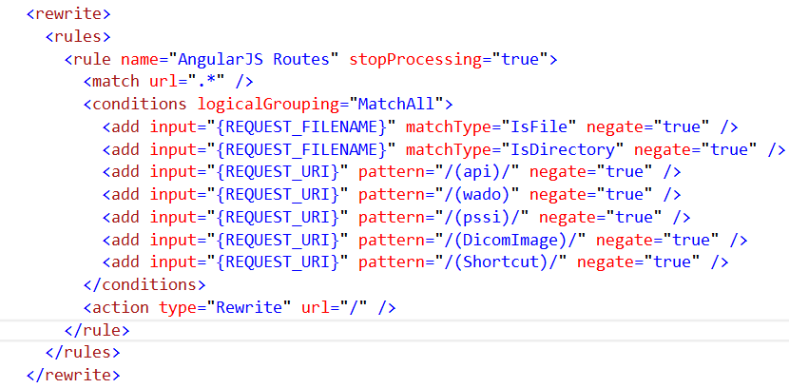
IIS Rewrite module
Deep URL
  Input deep URL directly in browser
IIS Rewrite pass URL to angular router.
  Install rewrite_amd64_en-US.msi
  Config Web.Config <rewrite>

Slide 5
Publish to IIS
Build angular with “ng build –prod”
Publish MVC project
Copy Angular output into MVC root folder
Index.html
  <base href=“/ApplicationPath/”>
Web.Config
  <action type="Rewrite" url="/" />

Slide 6
Debug Angular
Chrome – Augury plug in
IE – debug in VS2015

Slide 7
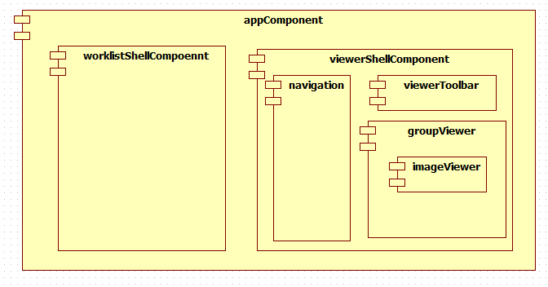
WebClient (Angular)
Components
Services
Workflow

Slide 8
Resource
https://angular.io/docs
https://angular.cn/

